Slide 1

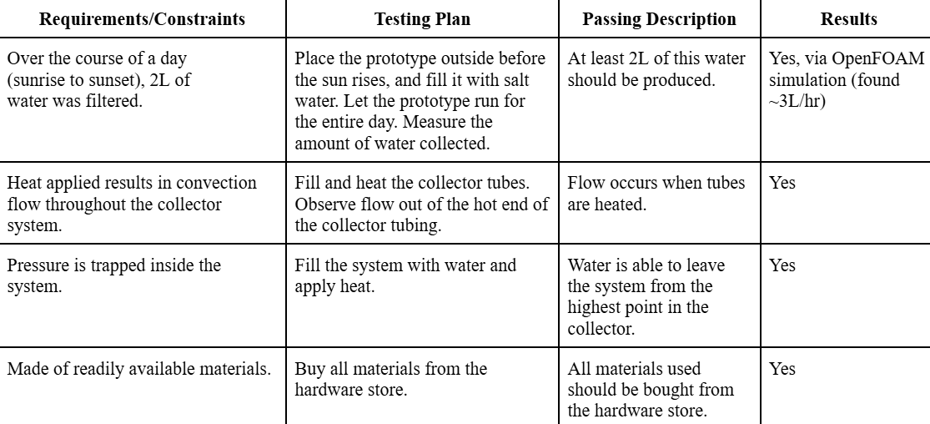
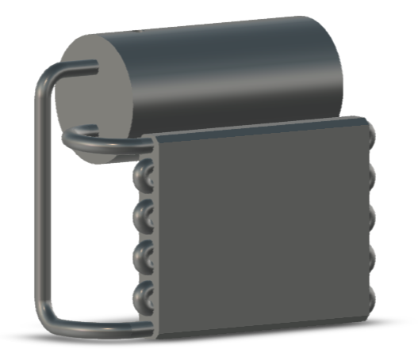
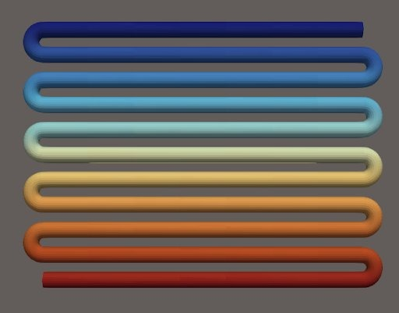
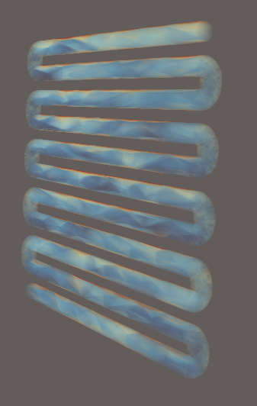
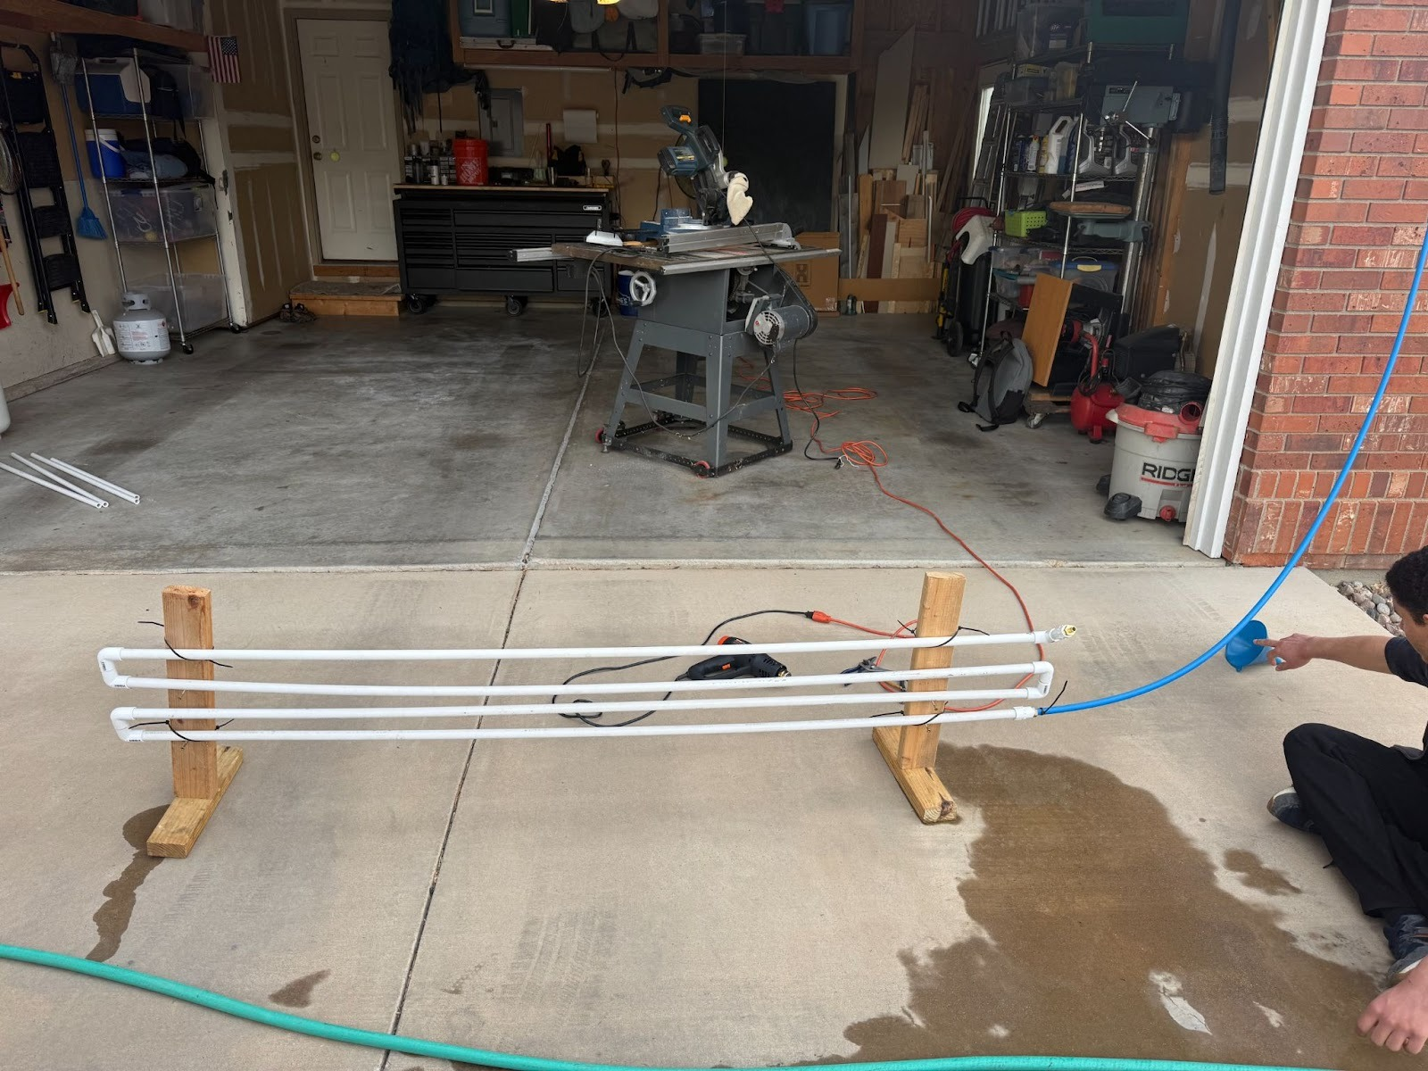
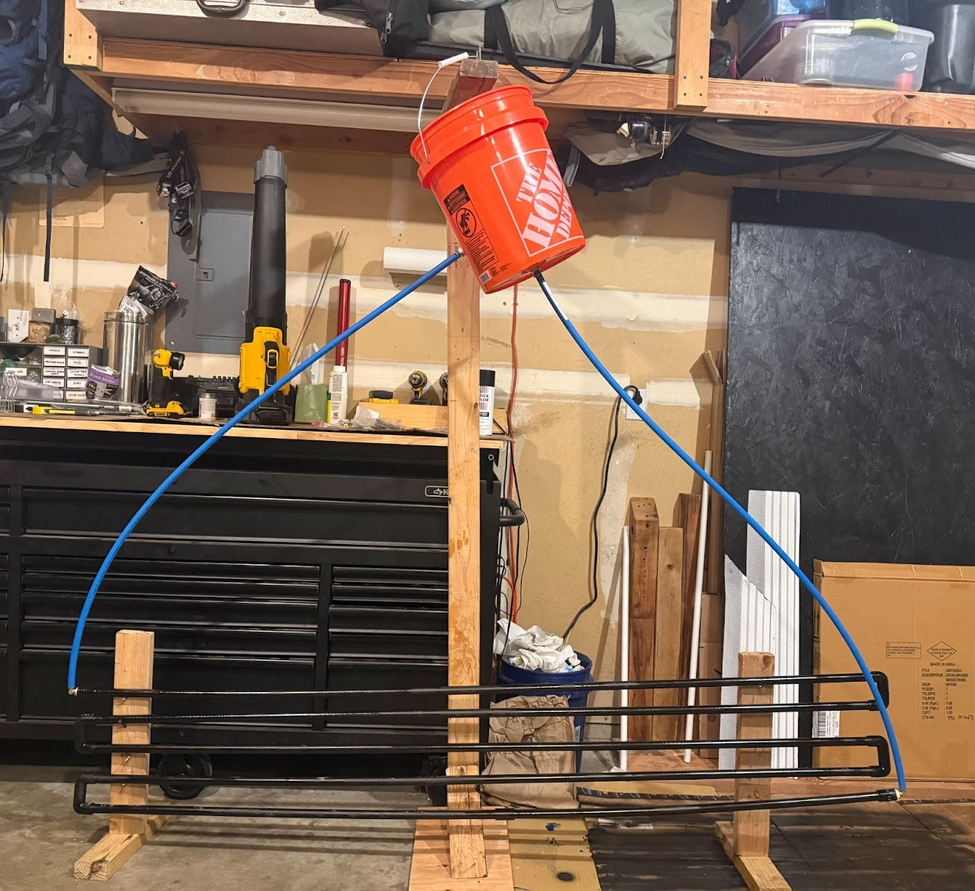
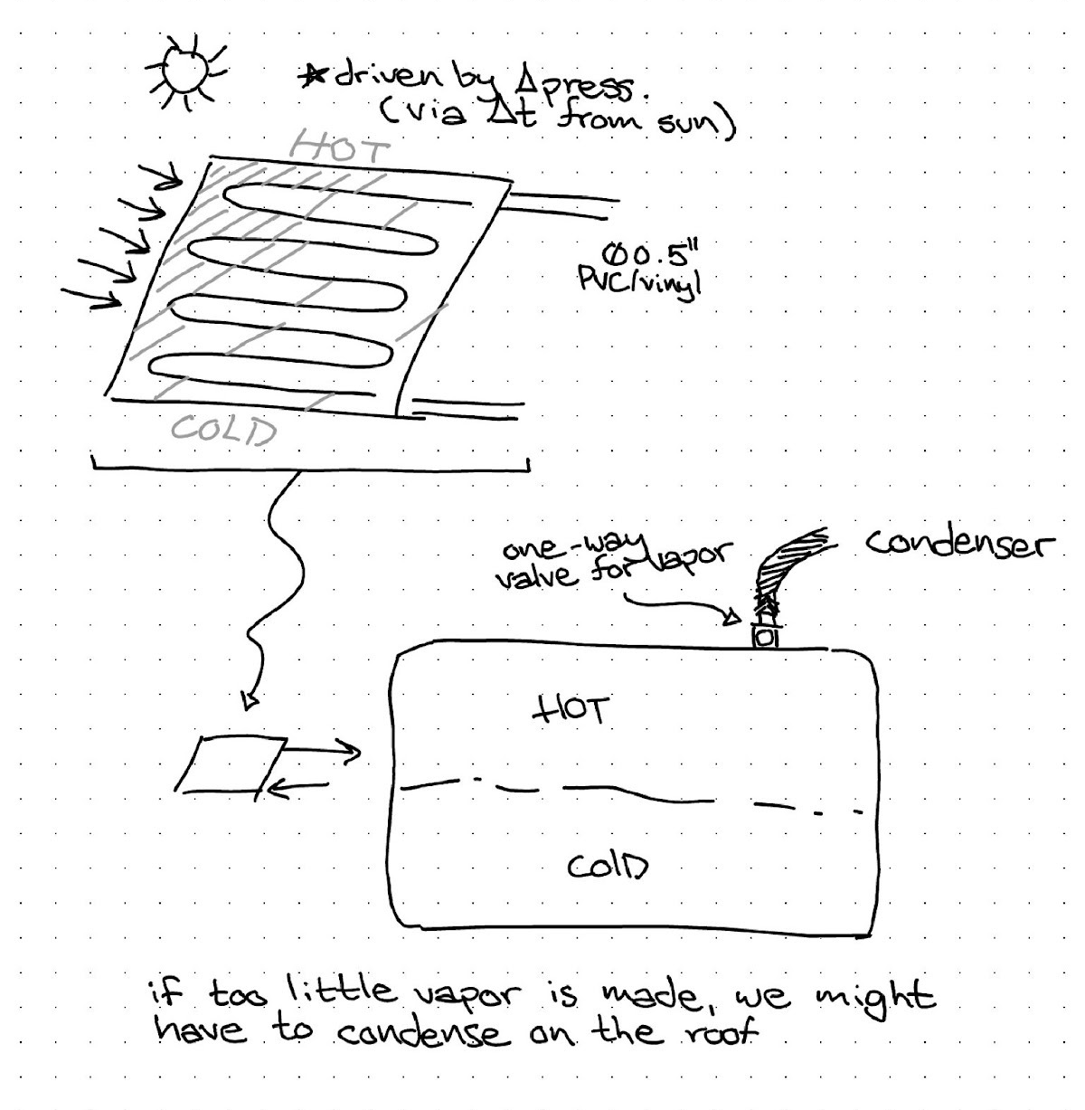
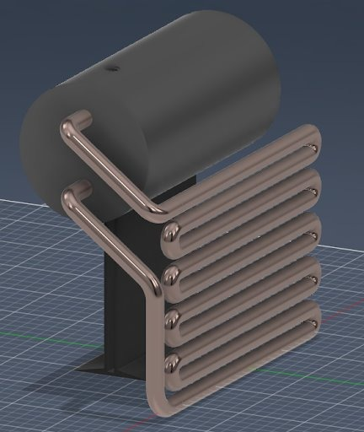

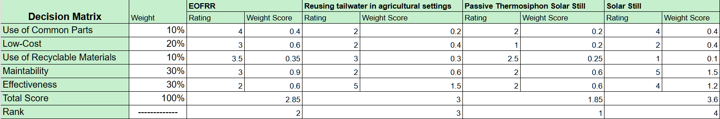
Passive Thermosiphon Solar Still
Mateo Vializ, Joseph Fiorenza, Gavin Crawford, Jack Friesen
Problem Statement
Prototyping
Testing/Results
Current desalination methods face high costs, high energy consumption, and brine disposal; therefore, we developed a passive thermosiphon solar still to combat these issues, utilizing natural convection and requiring no energy input.
We went through various iterations before we landed on our final CAD design pictured below. Using OpenFOAM, we validated our hypothesis about convection dynamics of our zero-power convection loop. We modeled heat and flow independently to confirm the ‘passive’ aspect of our project.
We used OpenFOAM simulations of the collector to determine its flow characteristics. The primary value we looked at was flow by velocity, which we can convert into total volumetric flow.
Motivation
Figure 7. Main Final Testing Results
According to UNICEF, over two billion people live in countries where water supply is inadequate. We originally turned to the conventional solar still. But quickly found out it was quite inefficient, producing only approximately 3L/per day. So, our group used a thermosiphon to create a high efficiency, low cost, energy efficient system.
Figure 3. Initial CAD design based upon preliminary design sketch
Requirements/Constraints
Figure 9.
Water Velocity Simulation
The requirements for our design were that it needed to make enough water for a person to survive over the span of a day, durable enough to survive outside weather conditions, sealed off so no water escapes, made of commonly available & recyclable materials, and it must function without electricity.
Our constraints in the design were that it had to be less than $60 and maintainable by an average person.
Figure 4. First physical design built from CAD design and preliminary research
Figure 8. Pressure Gradient Simulation
Conclusion
Design
Figure 5. Final physical prototype, with fixed leaks, mounted bucket, and painted pipes
Our thermosiphon design has been proven through simulations to provide about 3 liters of water throughput per hour. Our design features carefully calculated dimensions and construction details to provide a reliable way to provide clean water without electricity. Furthermore, our design is primarily recyclable.
To improve our design, we would run more batch simulations to determine the optimal collector design. Another improvement we could make is constructing a full-metal prototype with higher energy absorption and heat transfer.
Figure 1. Initial design sketch outlining basics of a thermosiphon.
Figure 6. Final CAD design used for OpenFOAM simulations
OpenFOAM Simulation
Figure 2. The design matrix we used to determine what solution best fit our requirements/constraints

